Slide 1
Trends in Distributed Systems
Y. V. Lokeswari AP / CSE
Reference: George Coulouris, Jean Dollimore and Tim Kindberg, “Distributed Systems Concepts and Design”, Fifth
Edition, Pearson Education, 2012

Slide 2
Trends in Distributed Systems
Pervasive networking technology.
Ubiquitous and mobile computing.
Distributed multimedia Systems.
Peer to Peer Systems.
Distributed computing as a utility (Cloud)
Cluster Computing
Grid Computing
Cloud Computing

Slide 3
Pervasive networking and Internet
Internet is a vast interconnected collection of computer networks.
Networked computers have become a pervasive resource and devices can be connected (if desired) at any time and in any place.
Internet is a very large distributed system.
It enables users, wherever they are, to make use of services such as the World Wide Web, email and file transfer.

Slide 4
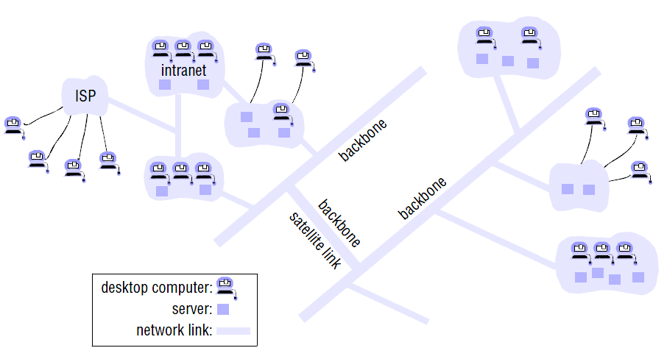
Trends in Distributed Systems
Pervasive networking technology.

Slide 5
Pervasive networking and Internet
Collection of intranets – subnetworks operated by companies and other organizations and typically protected by firewalls.
The role of a firewall is to protect an intranet by preventing unauthorized messages from leaving or entering.
Firewall is implemented by filtering incoming and outgoing messages. Filtering might be done by source or destination
Internet Service Providers (ISPs) are companies that provide broadband links and other types of connection to individual users and small organizations, enabling them to access services anywhere in the Internet.
Some organizations may not wish to connect their internal networks to the Internet due to security reasons.

Slide 6
Mobile and Ubiquitous Computing
Technological advances in device miniaturization and wireless networking have led increasingly to the integration of small and portable computing devices into distributed systems.
Laptop computers.
Handheld devices, including mobile phones, smart phones, GPS-enabled devices, pagers, personal digital assistants (PDAs), video cameras and digital cameras.
Wearable devices, such as smart watches with functionality similar to a PDA.
Devices embedded in appliances such as washing machines, hi-fi systems, cars and refrigerators.

Slide 7
Mobile and Ubiquitous Computing
Mobile computing is the performance of computing tasks while the user is on the move, or visiting places other than their usual environment.
In mobile computing, users who are away from their ‘home’ intranet (the intranet at work, or their residence) are still provided with access to resources via the devices they carry with them.
Ubiquitous computing is the harnessing of many small, cheap computational devices that will eventually become so pervasive in everyday objects.
The presence of computers everywhere only becomes useful when they can communicate with one another.
For example, it may be convenient for users to control their washing machine or their entertainment system from their phone or a ‘universal remote control’ device in the home.

Slide 8
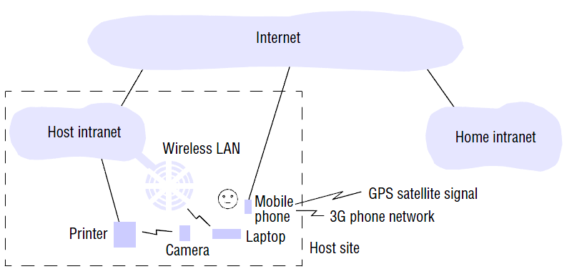
Trends in Distributed Systems
Mobile and Ubiquitous Computing

Slide 9
Distributed Multimedia Systems
Storing and rendering Images, Test messages
Should be able to store and locate audio or video files, to transmit them across the network.
live or pre-recorded television broadcasts, access to film libraries offering video-on-demand services.
Access to music libraries, Audio & Video conferencing
IP telephony, Skype
In a video presentation it is necessary to preserve a given throughput in terms of frames per second and, for real-time streams, a given maximum delay or latency for the delivery of frames.
Jitter:

Slide 10
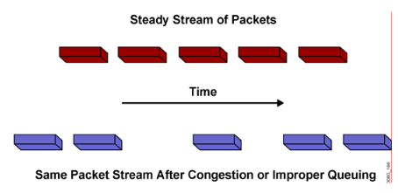
Distributed Multimedia Systems
Jitter is defined as a variation in the delay of received packets. The sending side transmits packets in a continuous stream and spaces them evenly apart. Because of network congestion, improper queuing, or configuration errors, the delay between packets can vary instead of remaining constant, as shown in the figure

Slide 11
Distributed Multimedia Systems
Webcasting is the ability to broadcast continuous media, typically audio or video, over the Internet. Eg: Skype
Distributed Systems should provide the following.
Support for an (extensible) range of encoding and encryption formats, such as the MPEG, JPEG, PNG
A range of mechanisms to ensure that the desired quality of service.
Resource management and Scheduling policies.
Adaptation strategies for changing demands

Slide 12
Peer to Peer Systems
It is collection of networked computer which share resources from its peer nodes.
Every node is independent and provide service to other nodes and at the same time request a service from other nodes too.
No master/slave architecture.
Any node can join or leave the network at any time.
It is not reliable and not secure.
Eg: Napster, Gnutella.

Slide 13
Distributed computing as a utility
A cluster computer is a set of interconnected computers that cooperate closely to provide a single, integrated high performance computing capability.
Blade servers are minimal computational elements containing for example processing and (main memory) storage capabilities.
A blade system consists of a potentially large number of blade servers contained within a blade enclosure.
Grid computing : Collection of computer dispersed across many co-operative/ collaborating organizations across globe who share resources for executing resource intensive applications. Mainly used in scientific applications.

Slide 14
Distributed computing as a utility
Resources are provided by appropriate service suppliers and effectively rented rather than owned by the end users.
Computing as an analogy to water, taxi and electricity,
IaaS: Physical resources such as storage and processing can be made available to networked computers
Data centers can be rented.
PaaS: OS virtualization enable services to be provided using virtual node.
SaaS: Software services such as gmail, distributed calender, Google Apps are provides as services on demand.

Slide 15
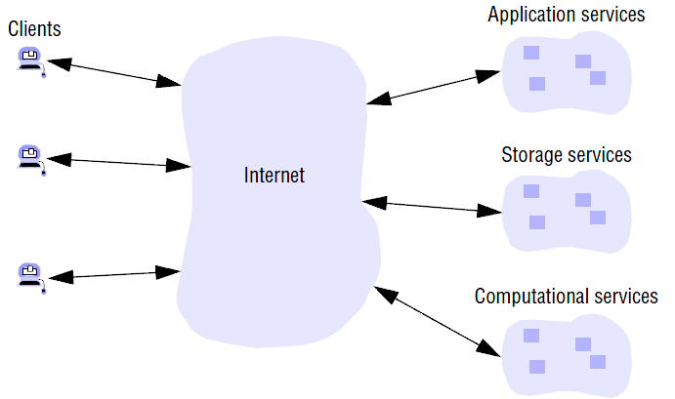
Trends in Distributed Systems
Cloud Computing

Slide 16
Parallel and Distributed Computing
Parallel Programming frameworks:
Task parallelism and
Data parallelism.
Apache foundation introduced the following open source frameworks
Hadoop Map Reduce (Parallel data processing)
Twister (Iterative Processing)
Mahout (Machine Learning)
Spark (Streaming, graphs, Machine learning and SQL)
Storm (real-time processing of data)
Flink (Stream and batch data processing)
Flume (collecting, aggregating, and moving large amounts of streaming event data)

Slide 17
Summary
Internet
Pervasive computing
Mobile and Ubiquitous computing
Distributed Multimedia systems
Peer to Peer Systems
Cluster computing
Blade System
Grid Computing
Cloud Computing
Parallel and Distributed Computing

